Slide 1
Software Cost Estimation
IS301 – Software Engineering
Lecture #37 – 2004-12-03*
M. E. Kabay, PhD, CISSP
Assoc. Prof. Information Assurance
Division of Business & Management, Norwich University
mailto:mkabay@norwich.edu V: 802.479.7937
*This lecture was accidentally left out of sequence
and was delivered on Monday 13 Dec 2004
Notes:
M. E. Kabay, PhD, CISSP

Slide 2
Objectives
To introduce the fundamentals of software costing and pricing
To describe three metrics for software productivity assessment
To explain why different techniques should be used for software estimation
To describe the principles of the COCOMO 2 algorithmic cost estimation model

Slide 3
Topics covered
Software productivity
Estimation techniques
Algorithmic cost modeling
Project duration and staffing

Slide 4
Fundamental estimation questions
How much effort is required to complete an activity?
How much calendar time is needed to complete an activity?
What is the total cost of an activity?
Project estimation and scheduling are interleaved management activities.

Slide 5
Software cost components
Hardware and software costs.
Travel and training costs.
Effort costs (the dominant factor in most
projects)
  The salaries of engineers involved in the project;
  Social and insurance costs.
Effort costs must take overheads into account
  Costs of building, heating, lighting.
  Costs of networking and communications.
  Costs of shared facilities (e.g library, staff restaurant, etc.).
Notes:
1-<number>
Copyright © 2004 M. E. Kabay. All rights reserved.

Slide 6
Costing and pricing
Estimates are made to discover the cost, to the developer, of producing a software system.
There is not a simple relationship between the development cost and the price charged to the customer.
Broader organizational, economic, political and business considerations influence the price charged.

Slide 7
Software pricing factors (1)
Market opportunity
  A development organization may quote a low price because it wishes to move into a new segment of the software market.
  Accepting a low profit on one project may give the opportunity of more profit later.
  The experience gained may allow new products to be developed.
Cost estimate uncertainty
  If an organization is unsure of its cost estimate, it may increase its price by some contingency over and above its normal profit.

Slide 8
Software pricing factors (2)
Contractual terms
  A customer may be willing to allow the developer to retain ownership of the source code and reuse it in other projects.
  The price charged may then be less than if the software source code is handed over to the customer.
Requirements volatility
  If the requirements are likely to change, an organization may lower its price to win a contract.
  After the contract is awarded, high prices can be charged for changes to the requirements.

Slide 9
Software pricing factors (3)
Financial health
  Developers in financial difficulty may lower their price to gain a contract.
  It is better to make a smaller than normal profit or break even than to go out of business.

Slide 10
Software productivity
A measure of the rate at which individual
engineers involved in software development
produce software and associated
documentation.
Not quality-oriented although quality assurance is a factor in productivity assessment.
Essentially, we want to measure useful
functionality produced per time unit.
Notes:
1-<number>
Copyright © 2004 M. E. Kabay. All rights reserved.

Slide 11
Productivity measures
Size-related measures
  Based on some output from the software process.
  This may be lines of delivered source code, object code instructions, etc.
Function-related measures
  Based on an estimate of the functionality of the delivered software.
  Function-points are the best known of this type of measure.
Notes:
1-<number>
Copyright © 2004 M. E. Kabay. All rights reserved.

Slide 12
Measurement problems
Estimating the size of the measure
  (e.g. how many function points).
Estimating the total number of programmer
months that have elapsed.
Estimating contractor productivity
  (e.g., documentation team) and
  incorporating this estimate in overall estimate.
Notes:
1-<number>
Copyright © 2004 M. E. Kabay. All rights reserved.

Slide 13
Lines of code (LOC)
What's a line of code?
  The measure was first proposed when programs were typed on cards with one line per card;
  How does this correspond to statements as in Java which can span several lines or where there can be several statements on one line?
What programs should be counted as part of the system?
This model assumes that there is a linear relationship between system size and volume of documentation.
Notes:
1-<number>
Copyright © 2004 M. E. Kabay. All rights reserved.

Slide 14
Productivity comparisons
The more verbose the programmer, the higher the productivity?
  But measures of productivity based on LOC suggest that programmers who write verbose code are more productive than programmers who write compact code (!)
The lower-level the language, the more productive the programmer?
  Same functionality takes more code to implement in a lower-level language than in a high-level language
Notes:
1-<number>
Copyright © 2004 M. E. Kabay. All rights reserved.

Slide 15
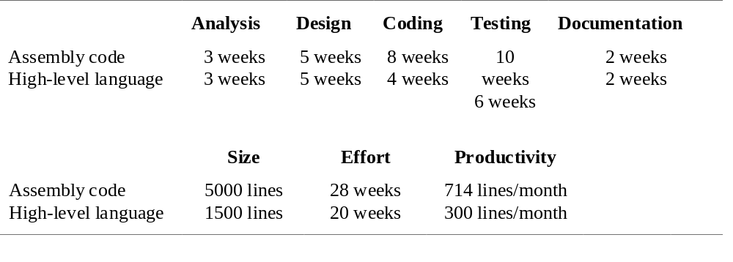
System development times

Slide 16
Productivity estimates
Real-time embedded systems, 40-160
LOC/P-month.
Systems programs , 150-400 LOC/P-month.
Commercial applications, 200-900
LOC/P-month.
In object points, productivity has been measured between 4 and 50 object points/month depending on tool support and developer capability.
Notes:
1-<number>
Copyright © 2004 M. E. Kabay. All rights reserved.

Slide 17
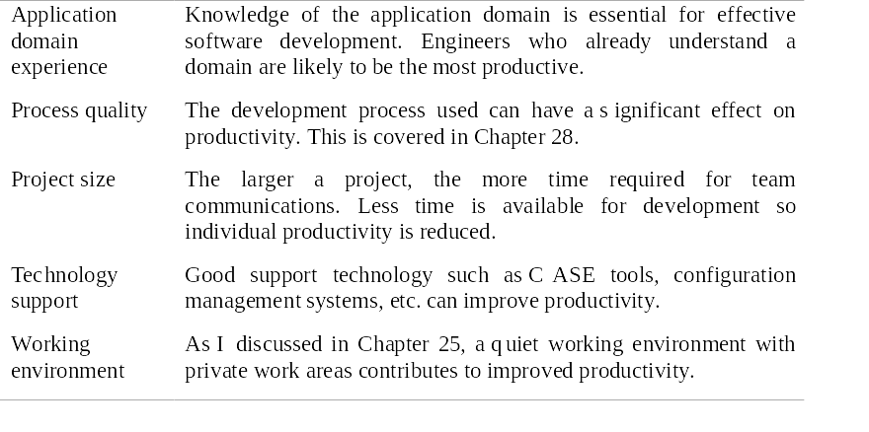
Factors affecting productivity
Notes:
1-<number>
Copyright © 2004 M. E. Kabay. All rights reserved.

Slide 18
Quality and productivity
All metrics based on volume/unit time are
flawed because they do not take quality into
account.
Productivity may generally be increased at the cost of quality.
It is not clear how productivity/quality metrics
are related.
If requirements are constantly changing then an approach based on counting lines of code is not meaningful as the program itself is not static.
Notes:
1-<number>
Copyright © 2004 M. E. Kabay. All rights reserved.

Slide 19
Estimation techniques
There is no simple way to make an accurate estimate of the effort required to develop a software system
  Initial estimates are based on inadequate information in a user requirements definition;
  The software may run on unfamiliar computers or use new technology;
  The people in the project may be unknown.
Project cost estimates may be self-fulfilling
  The estimate defines the budget and the product is adjusted to meet the budget.

Slide 20
Changing technologies
Changing technologies may mean that previous estimating experience does not carry over to new systems
  Distributed object systems rather than mainframe systems;
  Use of Web services;
  Use of ERP or database-centered systems;
  Use of off-the-shelf software;
  Development for and with reuse;
  Development using scripting languages;
  The use of CASE tools and program generators.

Slide 21
Estimation techniques
Algorithmic cost modeling.
Expert judgement.
Estimation by analogy.
Parkinson's Law.
Pricing to win.
Notes:
1-<number>
Copyright © 2004 M. E. Kabay. All rights reserved.

Slide 22
Estimation techniques (1)
Algorithmic cost modelling
  A model based on historical cost information that relates some software metric (usually its size) to the project cost is used.
  An estimate is made of that metric and the model predicts the effort required.
  Discussed in the text but not part of IS301

Slide 23
Estimation techniques (2)
DELPHI Technique -- Expert judgement consensus
Several experts on the proposed software development techniques and the application domain are consulted.
They each estimate the project cost.
These estimates are compared and the top and bottom quartiles are discussed.
The estimation process iterates until the range of estimates stabilizes

Slide 24
Delphi Technique (cont’d)
RAND Corporation, 2nd World War
Develop quantitative estimates using expert opinion
Ask top and bottom
quartiles to explain
reasons
Share reasons
Estimate again
Iterate to stability
Top Quartile
Estimates
Days

Slide 25
Estimation techniques (3)
Estimation by analogy
  Applicable when other projects in the same application domain have been completed.
  Cost of a new project is estimated by analogy with these completed projects.
Parkinson’s Law
  Work expands to fill the time available.
  Cost determined by available resources rather than by objective assessment.
  E.g., if the software has to be delivered in 12 months and 5 people are available, the effort required is estimated to be 60 person-months.

Slide 26
Estimation techniques (4)
Pricing to win
How
  The software cost is estimated to be whatever the customer has available to spend on the project.
  The estimated effort depends on the customer’s budget and not on the software functionality.
Advantages:
  You get the contract.
Disadvantages:
  The probability that the customer gets the system he or she wants is small.
  Costs do not accurately reflect the work required.

Slide 27
Top-down and bottom-up estimation
Any of these approaches may be used top-down or bottom-up.
Top-down
  Start at the system level
  Assess the overall system functionality and how this is delivered through sub-systems.
Bottom-up
  Start at the component level and estimate the effort required for each component.
  Add these efforts to reach a final estimate.

Slide 28
Top-down estimation
Usable without knowledge of the system architecture and the components that might be part of the system.
Takes into account costs such as integration, configuration management and documentation.
Can underestimate the cost of solving difficult low-level technical problems.
Notes:
1-<number>
Copyright © 2004 M. E. Kabay. All rights reserved.

Slide 29
Bottom-up estimation
Usable when the architecture of the system is known and components identified.
This can be an accurate method if the system has been designed in detail.
It may underestimate the costs of system level activities such as integration and documentation.
Notes:
1-<number>
Copyright © 2004 M. E. Kabay. All rights reserved.

Slide 30
Estimation methods
Each method has strengths and weaknesses.
Estimation should be based on several methods.
  If these do not return approximately the same result, then you have insufficient information available to make an estimate.
  Some action should be taken to find out more in order to make more accurate estimates.

Slide 31
Pricing to win
Pricing to win is sometimes the only applicable method.
This approach may seem unethical and un-businesslike.
However, when detailed information is lacking it may be the only appropriate strategy.
The project cost is agreed on the basis of an outline proposal and the development is constrained by that cost.
A detailed specification may be negotiated or an evolutionary approach used for system development.

Slide 32
Staffing requirements
Staff required can’t be computed by dividing the development time by the required schedule.
The number of people working on a project varies depending on the phase of the project.
The more people who work on the project, the more total effort is usually required.
A very rapid build-up of people often correlates with schedule slippage.

Slide 33
Key points
There is not a simple relationship between the price charged for a system and its development costs.
Factors affecting productivity include individual aptitude, domain experience, the development project, the project size, tool support and the working environment.
Software may be priced to gain a contract and the functionality adjusted to the price.

Slide 34
Key points
Different techniques of cost estimation should be used when estimating costs.
Algorithmic cost models support quantitative option analysis as they allow the costs of different options to be compared.
The time to complete a project is not proportional to the number of people working on the project.

Slide 35
Homework
Read all of Chapter 26
Study in detail only pp. 613-624:
  We are not including algorithmic estimation in the course details
Optional (because of lateness in term)
  By Tuesday 14 Dec 2004
  For up to 30 points, answer in detail any or all of
    26.1, 26.2, 26.4, 26.5, 26.10, 2.11 (@5)

Slide 36
DISCUSSION

